Slide 1
Indigence Issues in County Courts: The Labyrinth of Mental Health & Fines, Fees, and Costs
2018 Spring Judicial Education Session
March 21, 2018
(Overton Hotel & Conference Center)
Contributors and Presenters
The Honorable Mark Hocker, Lubbock County Court at Law #1 Judge
Jim Bethke, Lubbock Private Defender’s Office
Ashley Davis, Lubbock Criminal District Attorney’s Office
Philip Wischkaemper, Lubbock Private Defender’s Office

Slide 2
Today’s Agenda
Fair Defense Act
Fundamental requirements
Screening for indigence
NEW Assessing ability to pay (SB 1913)
Waiver of counsel provisions
Bail 17.151, CCP -- Release b/c of Delay
Mental Health Proceedings
16.22, CCP – assessment, screening, & reporting
17.032, CCP – release on personal bond
Funding or lack thereof . . .

Slide 3
Fair Defense Act

Slide 4
The Fair Defense Act
Fundamental Requirements:
  Conduct prompt Article 15.17, CCP Hearings (Magistration)
  Develop a Standard of Indigence and Process to Determine Eligibility
  Establish Minimum Attorney Qualifications
  Ensure Timely Appointment of Counsel
  Establish a Fair, Neutral, and Non-discriminatory Attorney Selection Process
  Promulgate a Standard Attorney Fee Schedule
Local Reporting Requirements:
  Indigent Defense Plan (judiciary)
  Indigent Defense Expenditures and Attorney Case Count (auditor/treasurer)
  Practice Time Figures (criminal defense attorneys)

Slide 5
Request for Counsel Checklist

Slide 6
Timelines for Appointment of Counsel
48 hours
24 hours
1 or 3 workdays
1 workday
Arrest
Magistration
(Request for
Counsel
Taken)
Art. 15.17(a)
Request for
Counsel
Received by
Appointing
Authority
Art. 15.17(a)
Appointing
Authority
Determines
Indigence and
Notifies
Counsel
Art. 1.051(c)
Appointed
Counsel
Contacts
Client
Art. 26.04(j)(1)

Slide 7
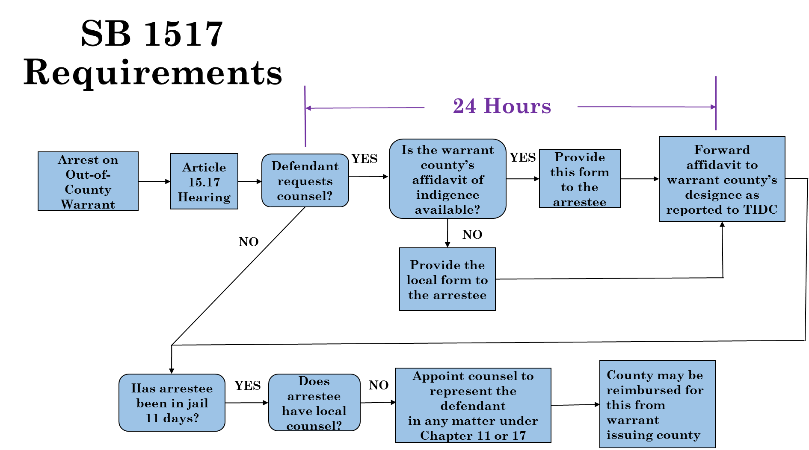
Counsel for Out of County Arrestees
Clarifies the procedures for appointment of counsel for a person arrested and jailed in a county based on a warrant issued by a different county, which has been confusing under prior existing law.
Out of County Arrest Contacts: http://tidc.tamu.edu/public.net/Reports/OutOfCountyArrestContacts.aspx

Slide 8


COUNTY BEST PRACTICE AWARD

Slide 9
Screening for Indigence
&
Assessing ability to pay
(SB 1913)

Slide 10
Waiver of Counsel for Purposes of Speaking with a Prosecutor

Slide 11
Waivers of Counsel – to speak with prosecutor
Texas Code Crim. Proc. Article 1.051
A defendant may voluntarily and intelligently waive in writing the right to counsel.
A waiver obtained in violation of Subsection (f-1) or (f-2) is presumed invalid.
Prosecutor may not communicate with defendant who has requested appointment of counsel unless court has denied the request
Court must advise defendant of procedures for requesting counsel

Slide 12
Waivers of Counsel – to enter a plea
Texas Code of Crim. Proc. Article 1.051
(g) If a defendant wishes to waive the right to counsel for purposes of entering a guilty plea or proceeding to trial, the court shall advise the defendant of the nature of the charges against the defendant and, if the defendant is proceeding to trial, the dangers and disadvantages of self-representation. If the court determines that the waiver is voluntarily and intelligently made, the court shall provide the defendant with a statement substantially in the following form, which, if signed by the defendant, shall be filed with and become part of the record of the proceedings:
"I have been advised this ______ day of __________, 2 ____, by the (name of court) Court of my right to representation by counsel in the case pending against me. I have been further advised that if I am unable to afford counsel, one will be appointed for me free of charge. Understanding my right to have counsel appointed for me free of charge if I am not financially able to employ counsel, I wish to waive that right and request the court to proceed with my case without an attorney being appointed for me. I hereby waive my right to counsel. (signature of defendant)"

Slide 13

Get Out-of-Jail-Free Card
Art. 17.151, CCP
State not ready for trial
  Felony—90 days
  Class A—30 days
  Class B—15 days
  “fine only”—5 days
Some Restrictions do Apply
Violation of Conditions of Release

Slide 14
mental health

Slide 15
Definitions
"Mental illness" means “an illness, disease, or condition, other than epilepsy, dementia, substance abuse, or intellectual disability, that:
  (A) substantially impairs a person's thought, perception of reality, emotional process, or judgment; or
  (B) grossly impairs behavior as demonstrated by recent disturbed behavior.
  -- Health & Safety Code § 571.003(14)

Slide 16
Definitions
"Intellectual disability" means “significantly subaverage general intellectual functioning that is concurrent with deficits in adaptive behavior and originates during the developmental period.”
"Subaverage general intellectual functioning" refers “to measured intelligence on standardized psychometric instruments of two or more standard deviations below the age-group mean for the tests used.”
  -- Health & Safety Code § 591.003(7-a) and (20)

Slide 17
Art. 16.22 Procedures

Slide 18
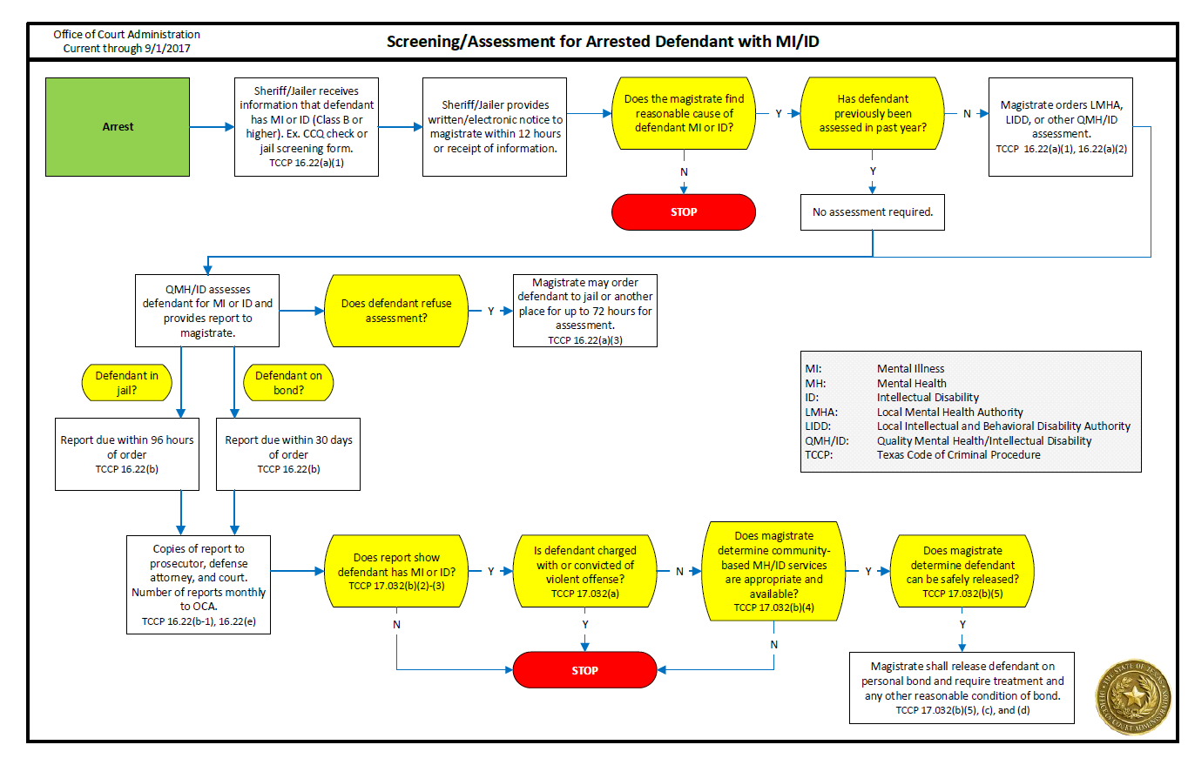
Art. 16.22 Flowchart

Slide 19
forms

Slide 20
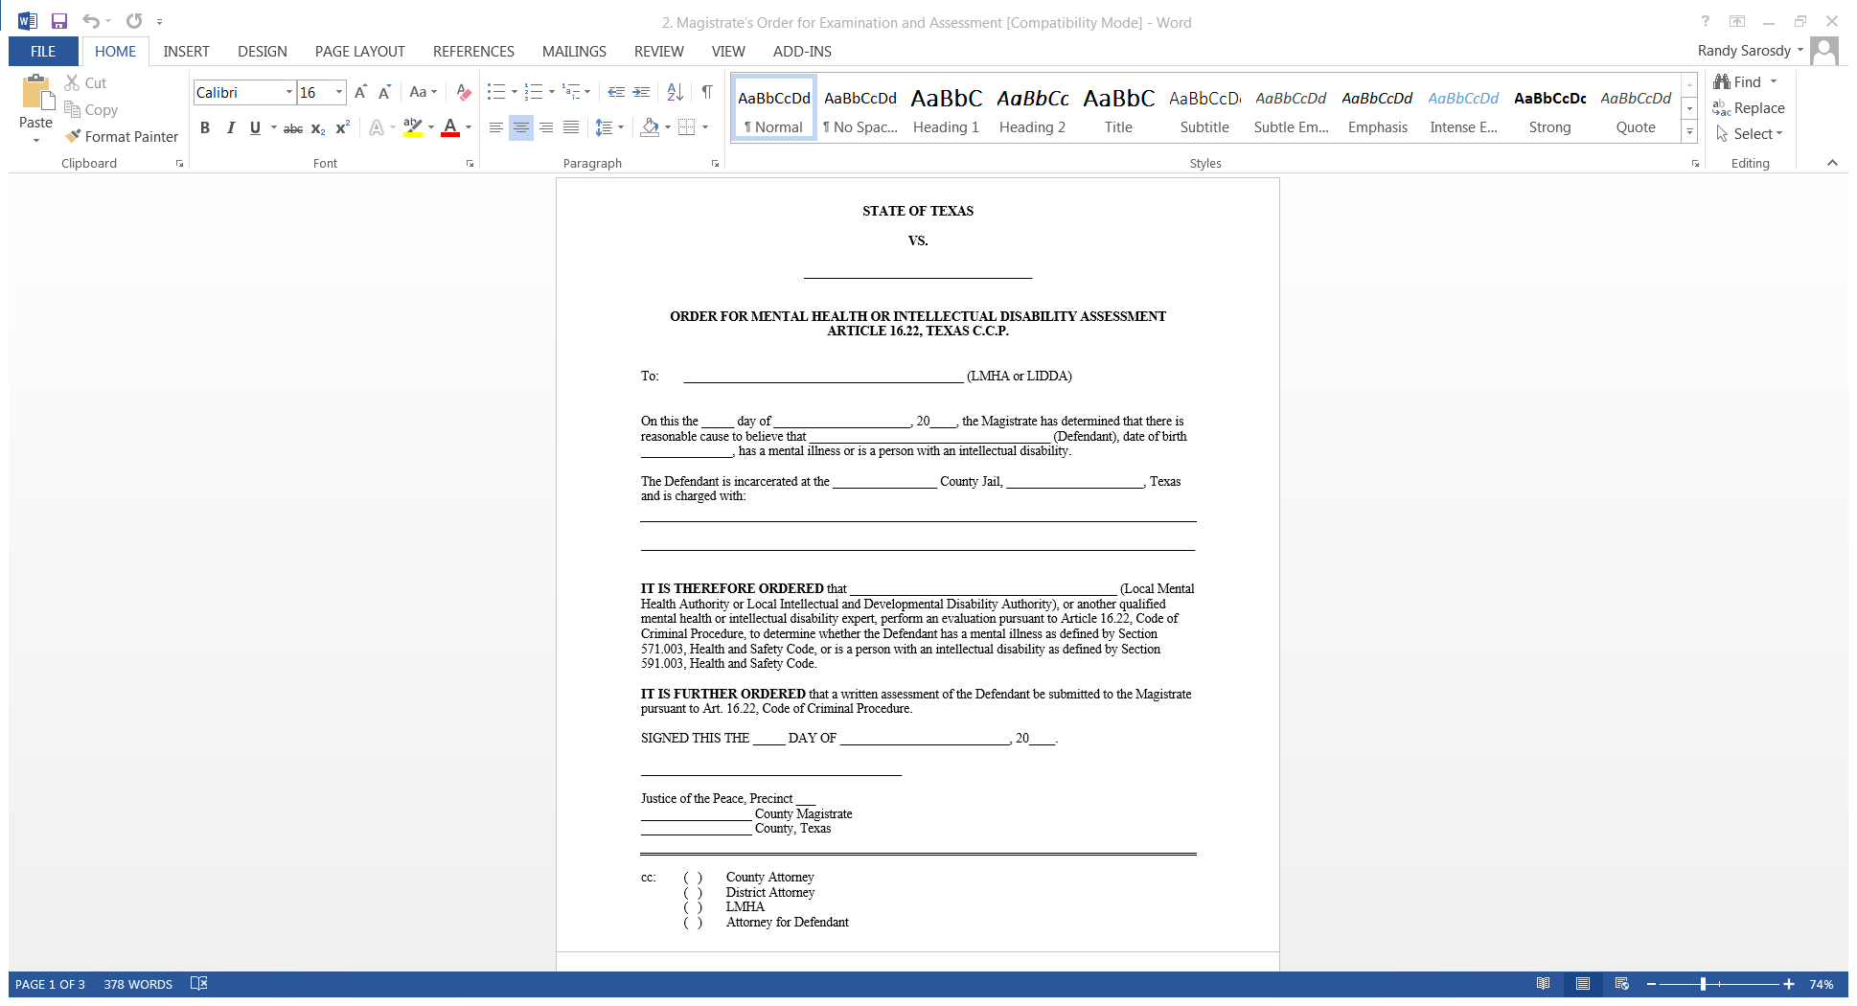
Magistrate’s Order for
Examination and Assessment

Slide 21
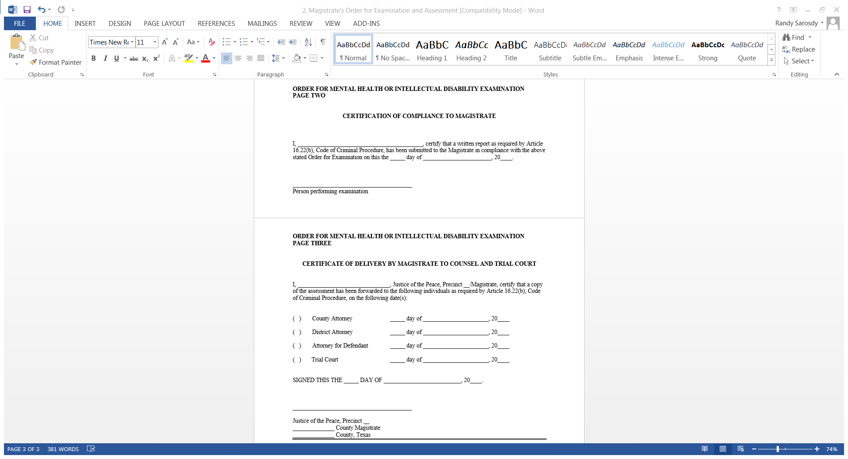
Magistrate’s Order for
Examination and Assessment

Slide 22
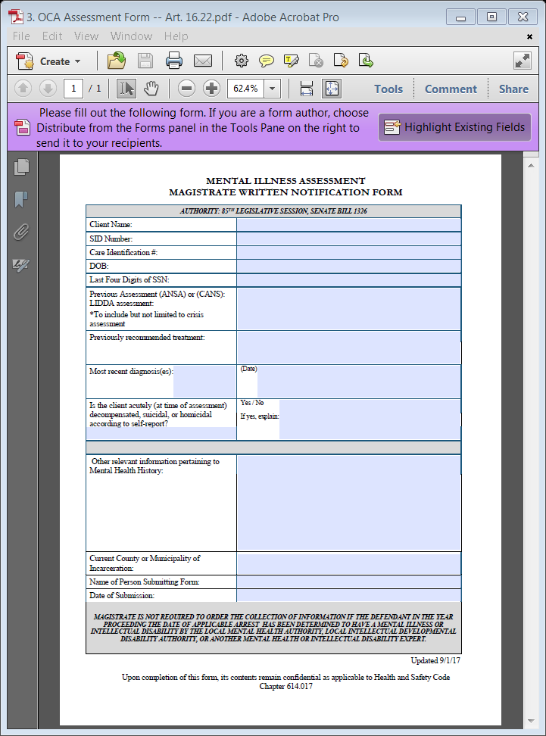
Assessment Form

Slide 23
Art. 16.22 Procedures / Reports to OCA
Magistrate SHALL submit to OCA on a monthly basis the number of written assessments provided to the court under Art. 16.22(a)(1)(B).
-- Art. 16.22(e)

Slide 24
Art. 16.22 Procedures / Reports to OCA
  “The number of written assessments will be captured from district and county courts on Judicial Council Monthly District and County Court Activity Reports, submitted by district clerks and county clerks.”

Slide 25
Art. 16.22 Procedures / Reports to OCA
OCA’s Mental Health Training page states:
  “The magistrate is required to provide copies of the assessment to the defense counsel, the attorney representing the state, and the trial court (district or county court). The magistrate should send the assessment to the custodian of the district or county court records—the district clerk or county clerk—for inclusion in the defendant’s case file.”

Slide 26
Art. 17.032 Procedures

Slide 27
Release on Personal Bond of Defendant with Mental Illness
A magistrate shall release a defendant on a personal bond . . . , unless good cause is shown otherwise, if the following five conditions apply:
  The defendant is not charged with and has not been previously convicted of a violent offense;
  (2) The defendant is examined under Article 16.22;
  (3) The expert: concludes that the D has a MI or ID and is competent to stand trial; and recommends MH or ID treatment;
  (4) The magistrate determines, in consultation with the local MH or IDD authority, that MH or ID services for the D are available; and
  (5) After considering all the circumstances, a pretrial risk assessment, if applicable, and any other credible information provided by a prosecutor or the defendant, the magistrate determines that release on personal bond would reasonably ensure the defendant's appearance in court and the safety of the community and the victim of the alleged offense.
-- Art. 17.032(b), Code of Criminal Procedure

Slide 28
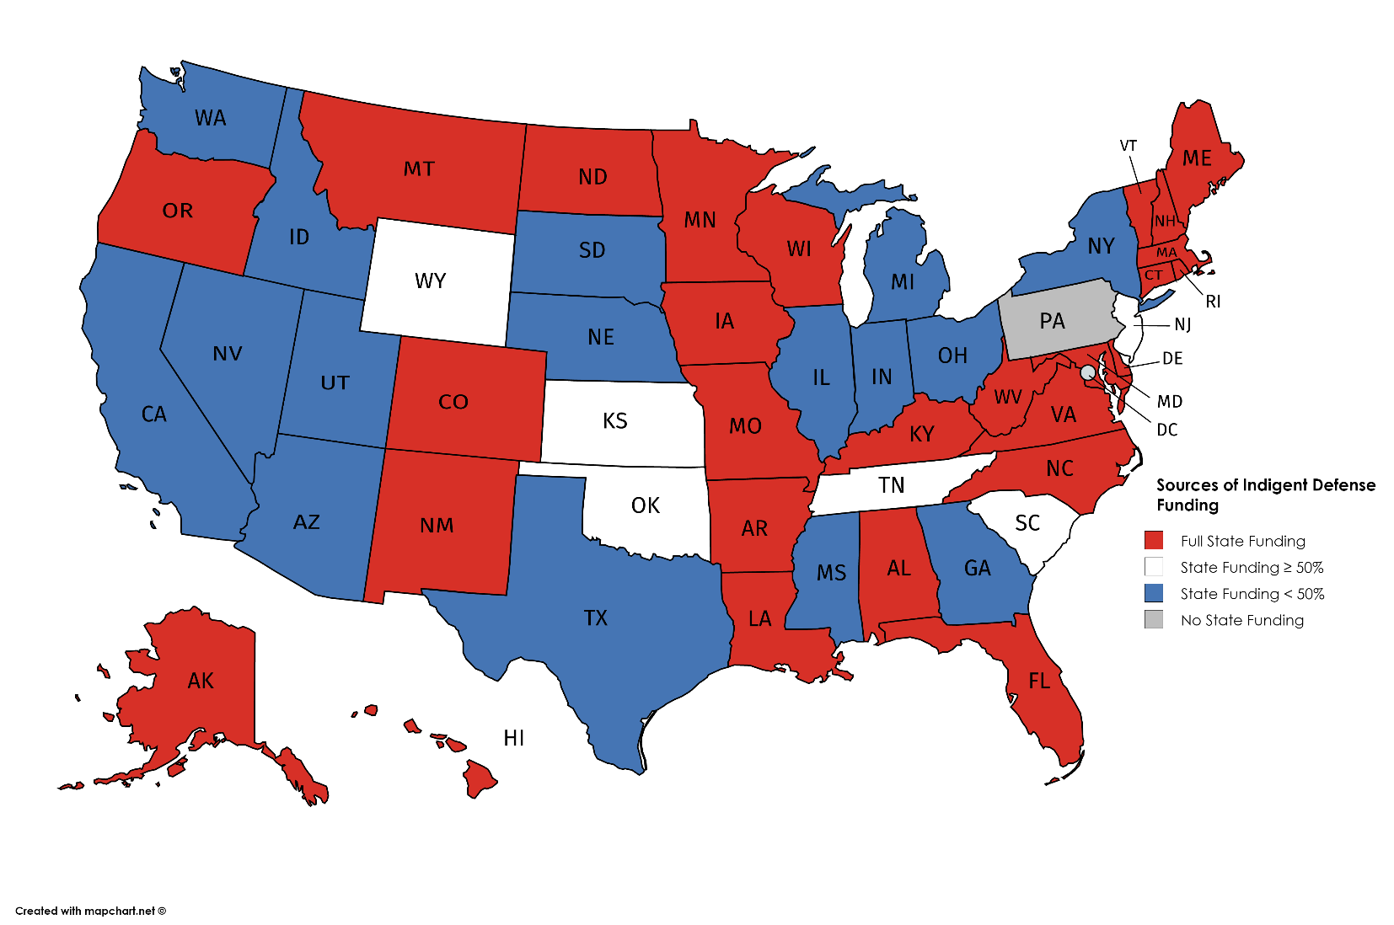
State Funding of Indigent Defense
More than half of states fully fund indigent defense.

